Slide 1
Cookie Sales Analysis
A Dive Into Profitability, Buyer Behaviour, And Flavour Popularity

Slide 2
Objective
Divine Foods want to get a better grasp of their sales, products, and customers to boost their sales and streamline their operations. Your job is to thoroughly analyse their data within a specified time frame.

Slide 3
Introduction 1.1
Overview of cookie types analysed: Chocolate Chip, Fortune Cookie, Oatmeal Raisin, Snickerdoodle, Sugar, White Chocolate Macadamia Nut.
Objective: To uncover insights into sales performance, profitability, customer preferences, and strategic recommendations for growth.

Slide 4
Introduction 1.2
Overview of the business:
Park & Shop Convenience Stores from AL, Owned By Yasmin Patel
Wholesome Foods from NY, Owned by Tamara Hyde
ABC Groceries from UT, owned by Mia Balm
Tres Delicious from WA, Owned By Sebastian Philippe
ACME Bites from WI, Owned By Jose Enrie

Slide 5
Approach
I will be looking Sales records, cost reports, profit margins, and transactions from different businesses.
Using Excel functionalities for data analysis, including pivot tables, graphs, and segmentation.
Main Focus was to look at Product performances, buyer insights, regional preferences

Slide 6
Limitations
The Dataset had errors
It was only between October 2023 to February 2024

Slide 7
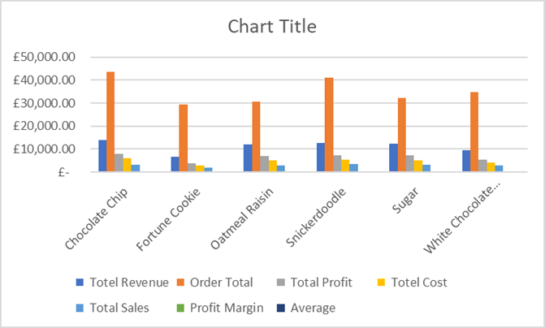
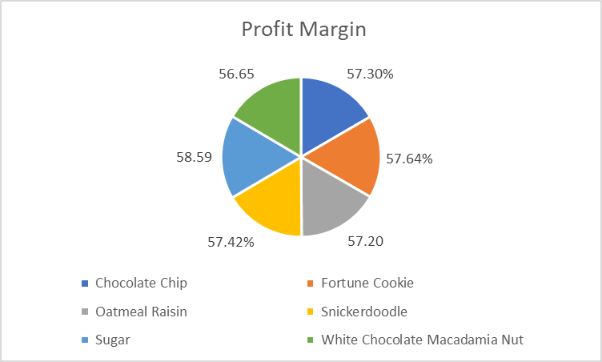
Key Findings 1
Chocolate Chip Dominance: Highest revenue earner at £13,775, signifying strong market preference.
Sugar Cookie Efficiency: Best cost-to-profit ratio with a 58.59% margin, showcasing exceptional production and pricing strategy.
Snickerdoodle Popularity: Leads with the highest order volume (41,139), which sold 3.400 over its duration
Profitability: All cookie types maintain a profit margin over 56%, reflecting solid financial health across the board.

Slide 8
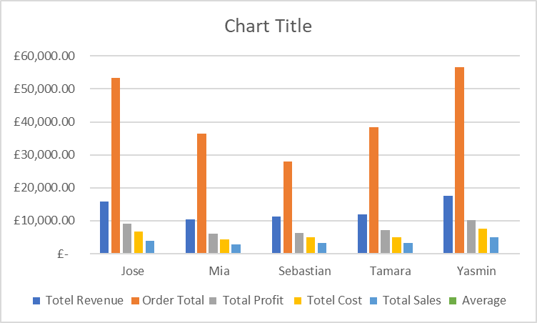
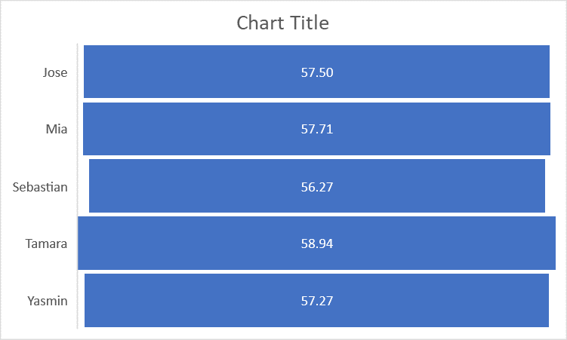
Key Findings 1.2
Park & Shop Convenience Stores Impact: Top buyer with significant contributions to revenue (£17,628) and profit (£10,095.95).
Wholesome Food Efficiency: Highest profit margin (58.94%), indicating transactions with her are particularly lucrative

Slide 9
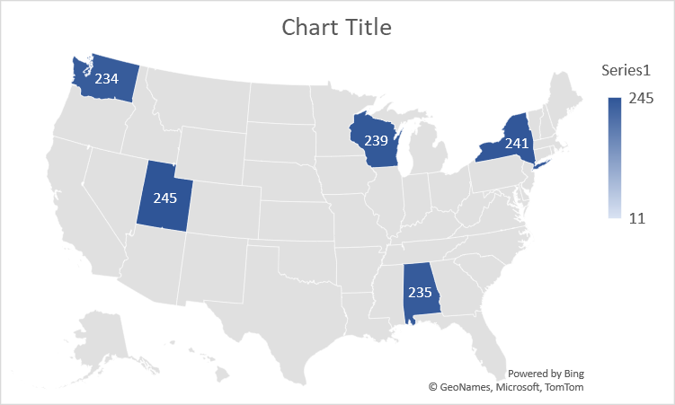
Key Findings 1.3
Jose Enrie: White Chocolate Macadamia Nut in Wisconsin (WI)
Mia Balm: Chocolate Chip in Utah (UT)
Sebastian Philppe: Snickerdoodle in Washington (WA)
Tamara Hyde: Oatmeal Raisin in New York (NY)
Yasmin Patel: White Chocolate Macadamia Nut in Alabama (AL)

Slide 10
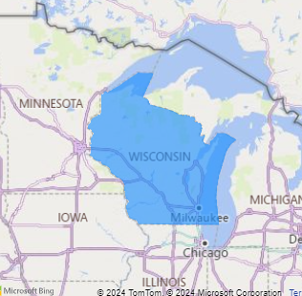
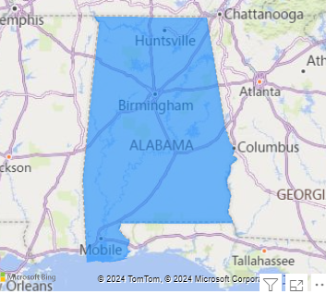
White Chocolate Macadamia Nut stands out as the most favoured in terms of revenue, particularly popular in Wisconsin and Alabama.

Slide 11
Recommendations
Focus on best-selling and profitable cookies.
Create special offers for top buyers like Yasmin Patel.
Target ads and promotions in states with high sales.
Find ways to make cookie production cheaper.
Use data to make decisions, like what cookies to sell more.
Increase the Research time

Slide 12
Conclusion
To grow and sell more, Divine Foods Inc. should sell more of what people like, keep their best customers happy, and look for new places and ways to sell. Also, making cookies for less money and using sales data will help make better choices. This plan uses our findings to help Divine Foods Inc. do better.

